Slide 1


PRESENTATION
BASIC ELECTRICAL THEORY AND PRINCIPLES
TRILOGIX TRAINING INSTITUTE

Slide 2


COURSE OBJECTIVES
At the end of this presentation, the participants will be able to:
State basic electrical safety rules
Define electrical quantities and ohm’s law
Compute electrical values using ohm’s law formulas
Analyze and calculate different types of circuits
Understand the importance of grounding and electrical protection

Slide 3
BASIC ELECTRICAL TERMS
AC and DC: Abbreviations for alternating current and direct current respectively. Current - A movement of electricity analogous to the flow of a stream of water. Direct Current - An electric current flowing in one direction only (i.e. current produced using a battery). Alternating Current - a periodic electric current that reverses its direction at regular intervals.
Amp or Ampere: The unit of intensity of electrical current (the measure of electrical flow), is abbreviated a or A.
Circuit Breaker: A device designed to open and close a circuit by non-automatic means and to open the circuit automatically on a predetermined over current without damaging itself when operated according to its rating.
Circuit: A complete path from the energy source through conducting bodies and back to the energy source.
Fuse: An over current protective device with a circuit opening part that is heated and broken by the passage of an over current through it.
Kilowatt-hour: Work done at the steady rate equivalent to 1000 watts in one hour. Power utility companies’ base their billing upon the number of kilowatt-hours (KWH) consumed.

Slide 4
BASIC ELECTRICAL TERMS
Ohm: The unit of electrical resistance and impedance, abbreviated with the symbol omega, Ω. Resistance is the opposition offered by a substance to the passage of electrical current. Impedance is the apparent resistance in a circuit to the flow of alternating current.
Ohm's Law: A statement of the relationship, discovered by the German scientist G. S. Ohm, between the voltage, amperage and resistance of a circuit. It states the voltage of a circuit in volts is equal to the product of the amperage in amperes and the resistance in ohms. E=IR
Over current: Any current in excess of the rated current or ampacity. It may result from overload, short circuit or ground fault.
Overload: Operation in excess of normal full-load rating or rated ampacity which could cause damage or dangerous overheating if continued for a sufficient time. A fault, such as a short circuit or ground fault, is not an overload. See "Over Current".
Volt: the unit of electromotive force, the measure of electrical pressure, is abbreviated v or V, and voltage is represented by V. The voltage (of a circuit) is the effective (greatest root-mean square) difference of potential between any two conductors of the circuit concerned.
Watt: the unit of power or rate of work represented by a current of one ampere under a pressure of one volt (abbreviated w or W). The English horsepower is approximately equal to 746 watts. Wattage ratings of lamps actually measure the power consumption not the illuminating capability.

Slide 5
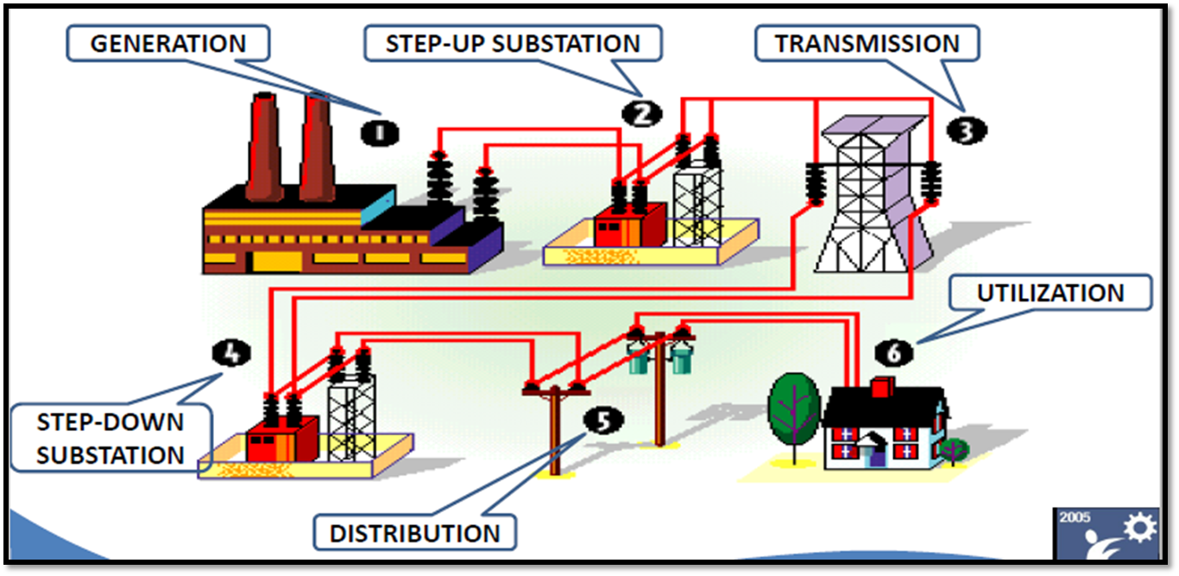
ELECTRICAL POWER SYSTEM

Slide 6
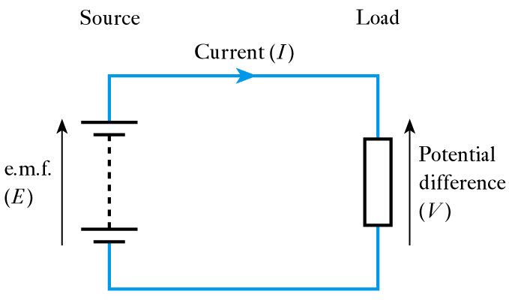
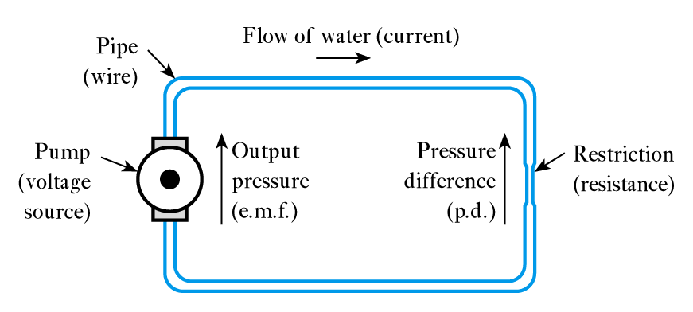
WHAT IS ELECTRICITY?
Electrical Circuit
Electricity is a source of energy to power devices (e.g., lights, electrical drill, or a computer)
If you compare electricity to water, voltage is the water pressure and current is the rate of flow.
Just as with water, the higher the voltage (pressure) or greater the current (flow rate), the more dangerous electricity becomes.
Water-Based Analogy

Slide 7
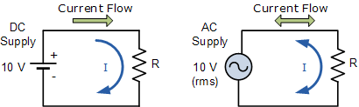
TYPES OF ELECTRICAL ENERGY
When the current flowing in a conductor always flows in the same direction this is direct current (DC).
Power sources are generally supplied by batteries.
Batteries in cell phones, lap tops, flashlights, uninterruptible power supplies (UPS) or vehicles are sources of direct current.
When the direction of the current periodically changes this is alternating current (AC).
Power sources are generally supplied by generators found at hydroelectric, coal fired, or nuclear power plants.
AC energy is distributed by above or underground power lines for end use in home, commercial, and industrial applications.

Slide 8

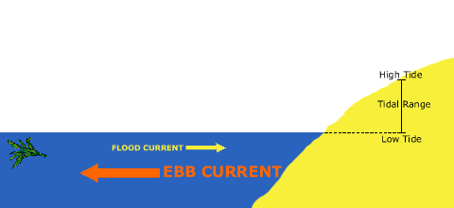
TYPES OF ELECTRICAL ENERGY

Slide 9
INTERNATIONAL SYTEM UNITS
Quantity | Quantity symbol | Unit | Unit symbol
Capacitance | C | Farad | F
Charge | Q | Coulomb | C
Current | I | Ampere | A
Electromotive force | E | Volt | V
Frequency | f | Hertz | Hz
Inductance (self) | L | Henry | H
Period | T | Second | s
Potential difference | V | Volt | V
Power | P | Watt | W
Resistance | R | Ohm | Ω
Temperature | T | Kelvin | K
Time | t | Second | s

Slide 10
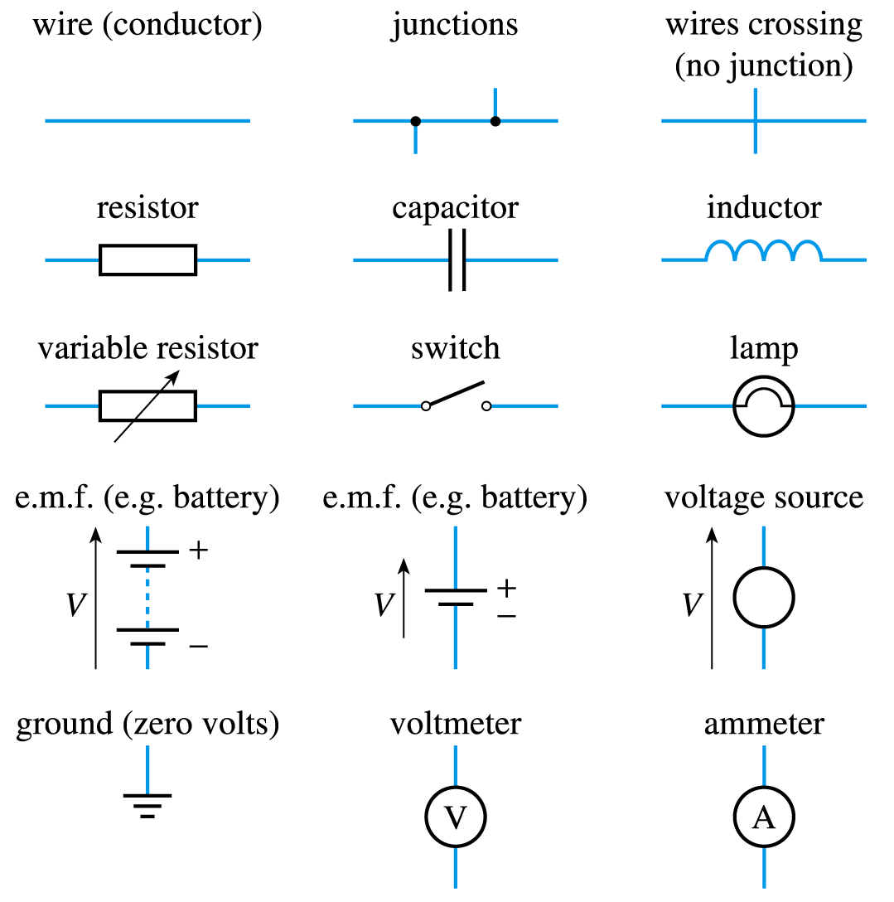
CIRCUIT SYMBOLS

Slide 11
CIRCUIT SYMBOLS

Slide 12
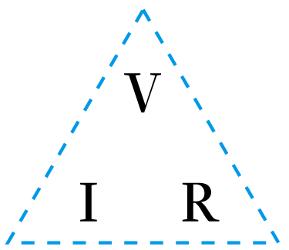
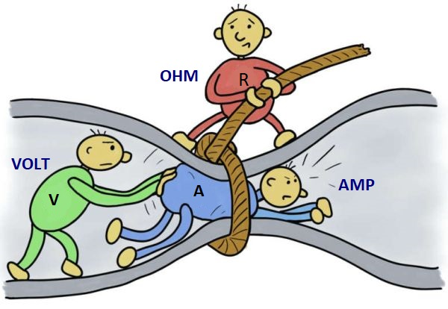
OHM’S LAW
“The current flowing in a conductor is directly proportional to the applied voltage (V )and inversely proportional to its resistance (R).”
I = V/R
V = IR
R = V/I

Slide 13
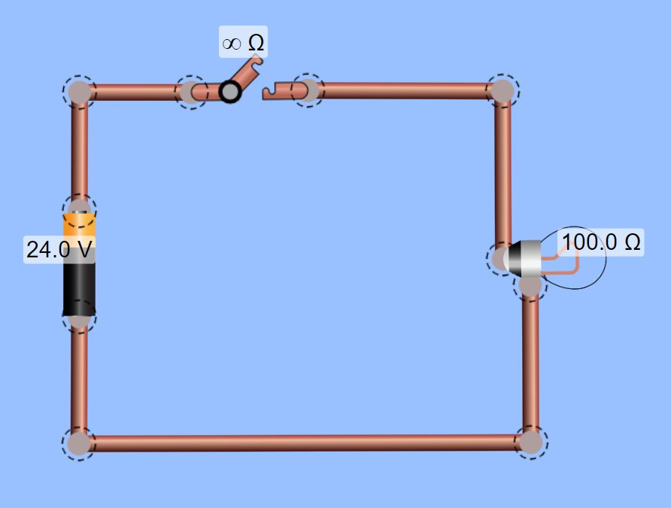
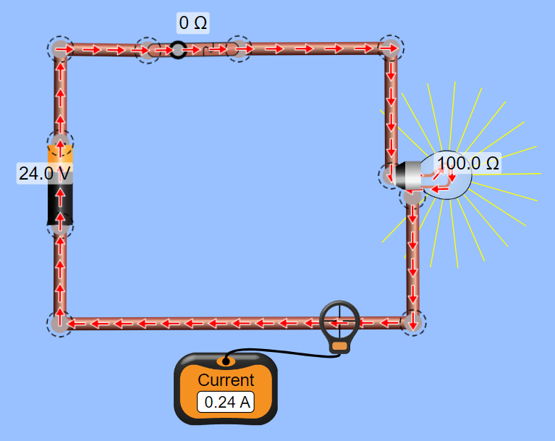
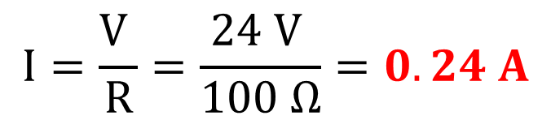
OHM’S LAW: EXAMPLE
Current (A)
Solution:
$$I=\frac{V }{R}=\frac{24 V }{100 Ω}=0.24 A$$

Slide 14
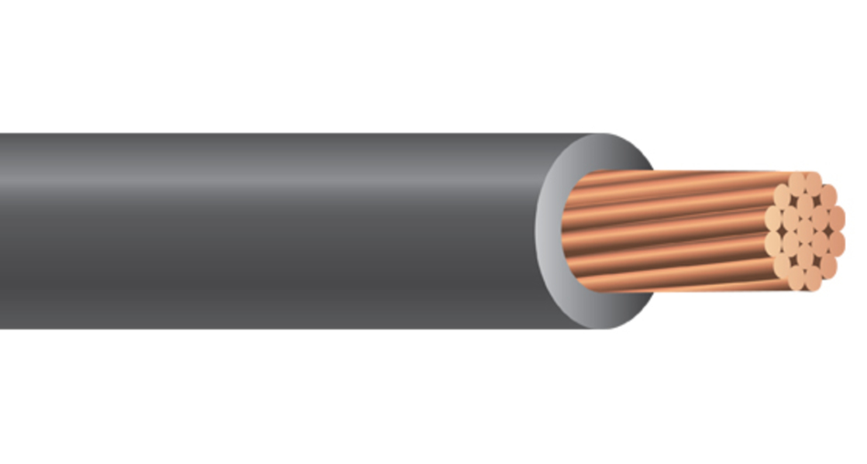
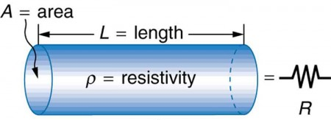

RESISTANCE VARIATION
Electrical Power Cable
Insulator
Where:
R= Resistance(Ω)
ρ= Resistivity or Specific resistance(Ω.m)
L = Length of the conductor(m)
A= Cross-sectional area of the conductor(m)
Resistivity at 20°C
Hard-drawn copper = 1.77x10⁻⁸ Ω.m
Annealed copper = 1.72x10⁻⁸ Ω.m
Aluminum = 2.83x10⁻⁸ Ω.m
Conductor
$$R= \frac{ρ x L}{A}$$

Slide 15
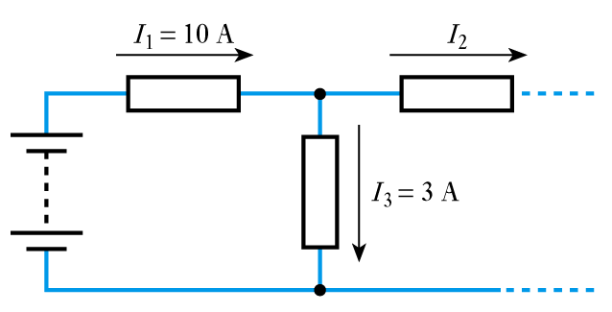
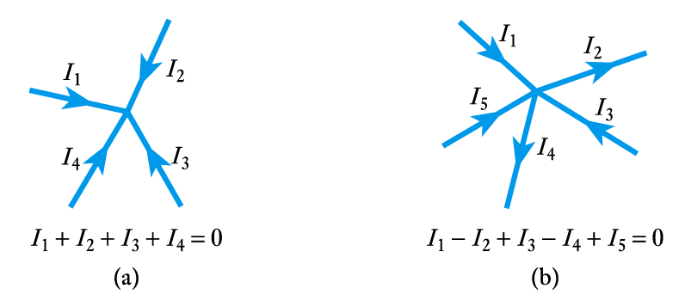
KIRCHHOFF’S CURRENT LAW
“At any instant, the algebraic sum of all the currents flowing into any node in a circuit is zero.”
Example:
if currents flowing into the node are positive, currents flowing out of the node are negative then;
Current entering equals current leaving
Solution:
I₁ – I₂ – I₃ = 0
I₂ = I₁ – I₃
I₂ = 10 – 3
I₂ = 7 A

Slide 16
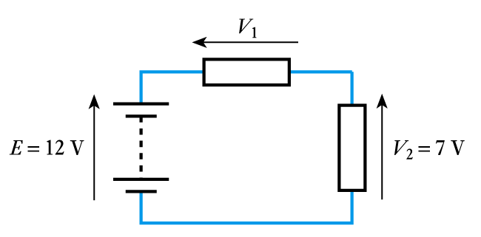
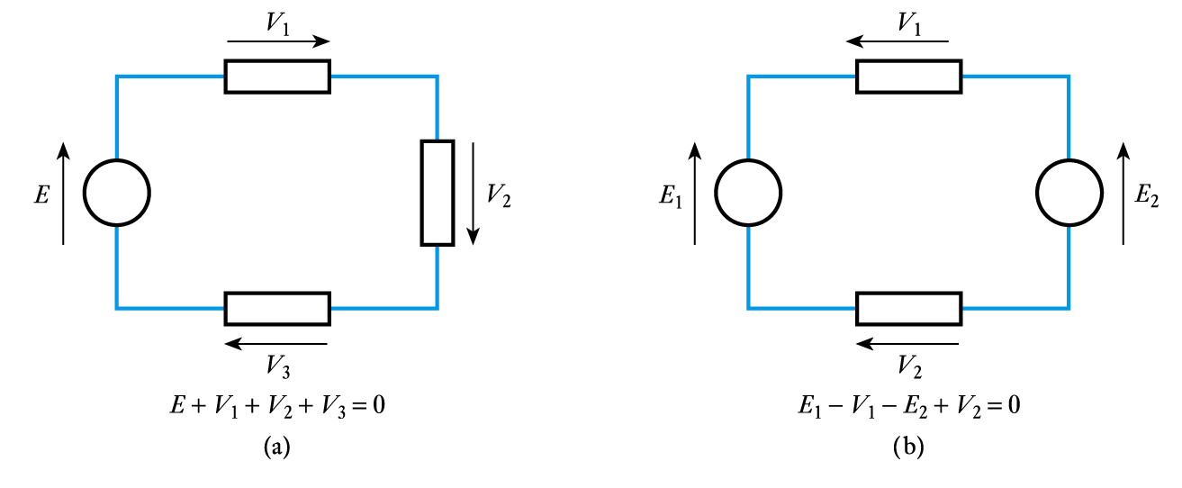
KIRCHHOFF’S VOLTAGE LAW
“At any instant the algebraic sum of the voltages around any loop in a circuit is zero.”
Example:
if clockwise voltage arrows are positive and anticlockwise arrows are negative then;
Solution:
E – V₁ – V₂ = 0
V₁ = E – V₂
V₁ = 12 – 7
V₁ = 5 V

Slide 17
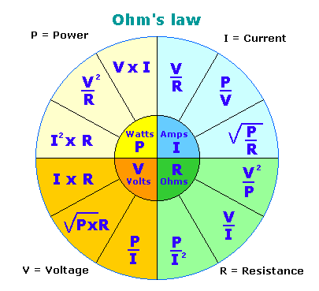
ELECTRICAL POWER
The instantaneous power dissipation (P) of a resistor is given by the product of the voltage across it and the current passing through it.
Power is measured in Watts.
Combining this result with Ohm’s law gives;
P = VI
P = I²R
P = V²/R

Slide 18
REVIEW QUESTIONS
1. An electric heating element has a resistance of 16 Ω and is connected to a voltage of 120 V. How much current will flow in this circuit? 7.5 A
2. How many watts of heat are being produced by the heating element in question 1? 900 W
3. A 240-V circuit has a current flow of 20 A. How much resistance is connected in the circuit? 12 Ω
4. An electric motor has an apparent resistance of 15 Ω. If 8 Amp of current are flowing through the motor, what is the connected voltage? 120 V
5. A 240-V air conditioning compressor has an apparent resistance of 8 Ω. How much current will flow in the circuit? 30 A
6. How much power is being used by the motor in question 5? 7200 W

Slide 19
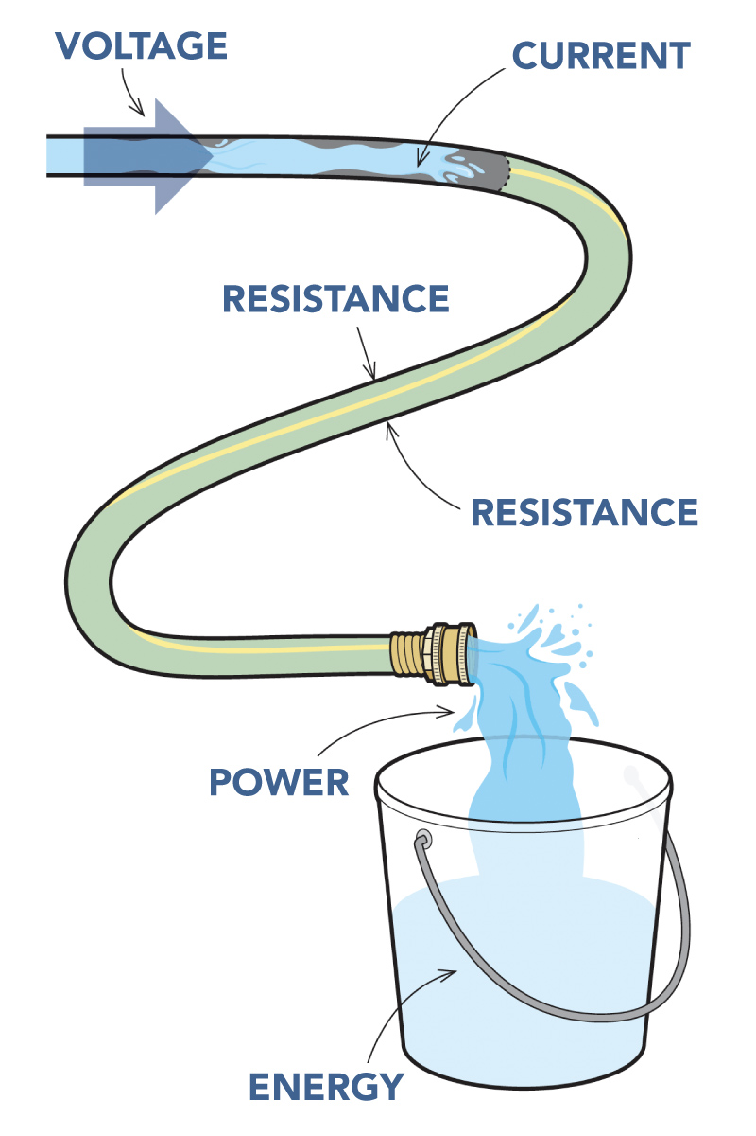
ELECTRICAL ENERGY
Power = Voltage x Current
Unit of Power = Watts (W)
Unit of Voltage = Volts (V)
Unit of Current = Amperes (A)
Energy = Power x Time
Unit of Energy = Watt-hour (kWh)

Slide 20
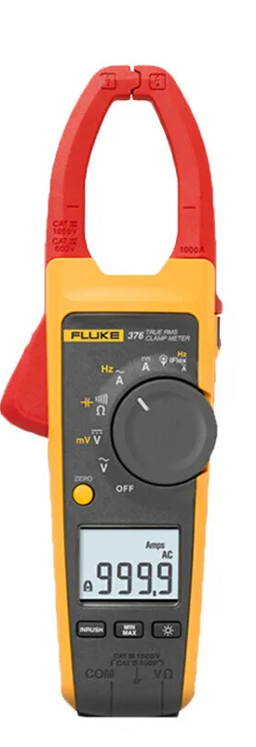
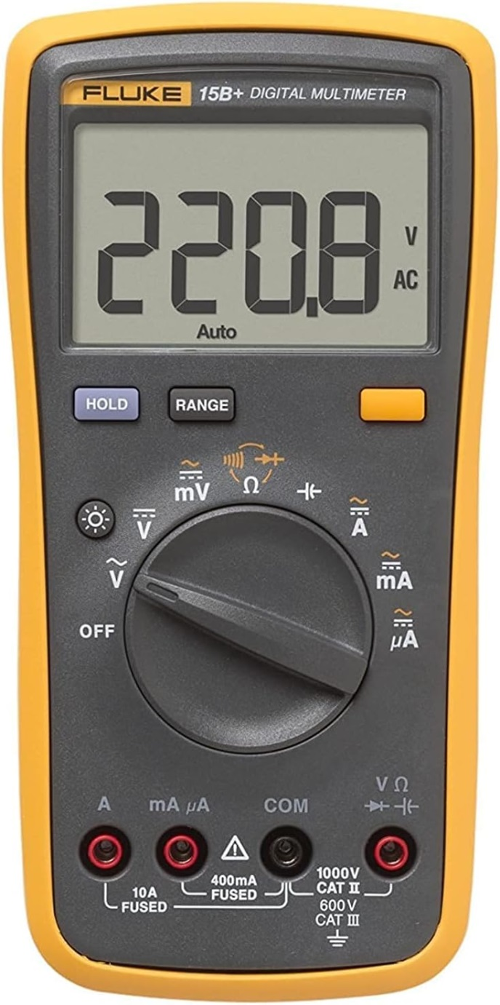
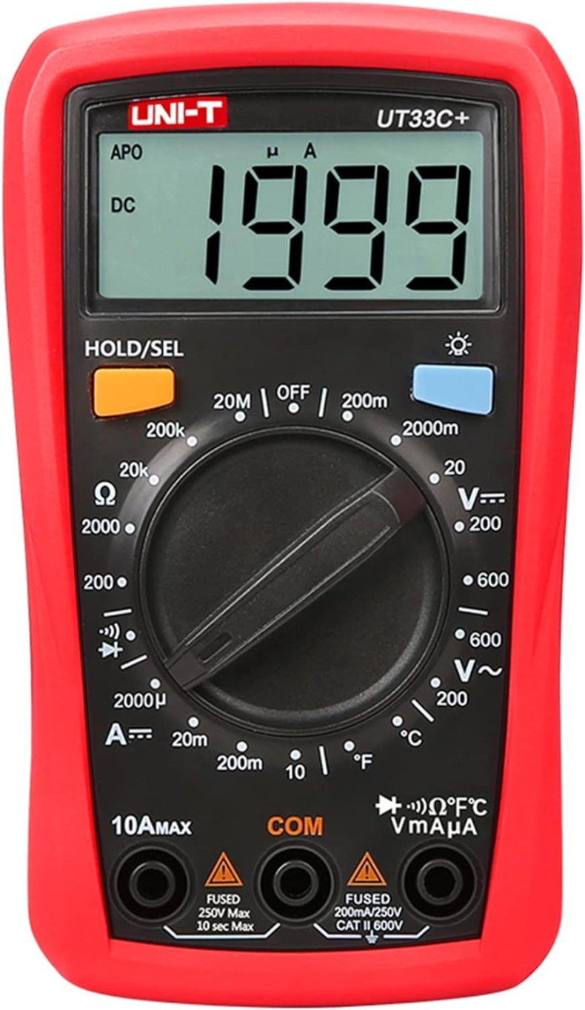
MULTIMETER
Golden Rule: Test before touch!
“Never assume that the circuit is off.”

Slide 21
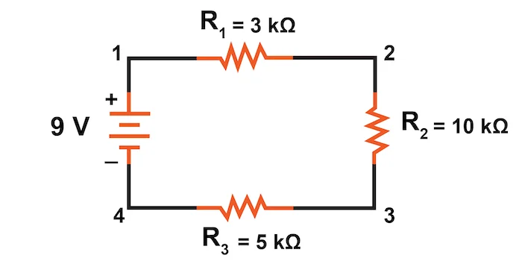
SERIES CIRCUITS
The current flowing through every series component is equal.
The total resistance (R_{T}) is equal to the sum of all of the resistances (R₁ + R₂ + R₃).
The sum of all of the voltage drops (V_{R1} + V_{R2} + V_{R3}) is equal to the total applied voltage (V_{T}). Refer to Kirchhoff’s Voltage Law.
I_{T} = I₁ = I₂ = I₃
R_{T} = R₁ + R₂ + R₃
V_{T} = V_{R1} + V_{R2} + V_{R3}

Slide 22
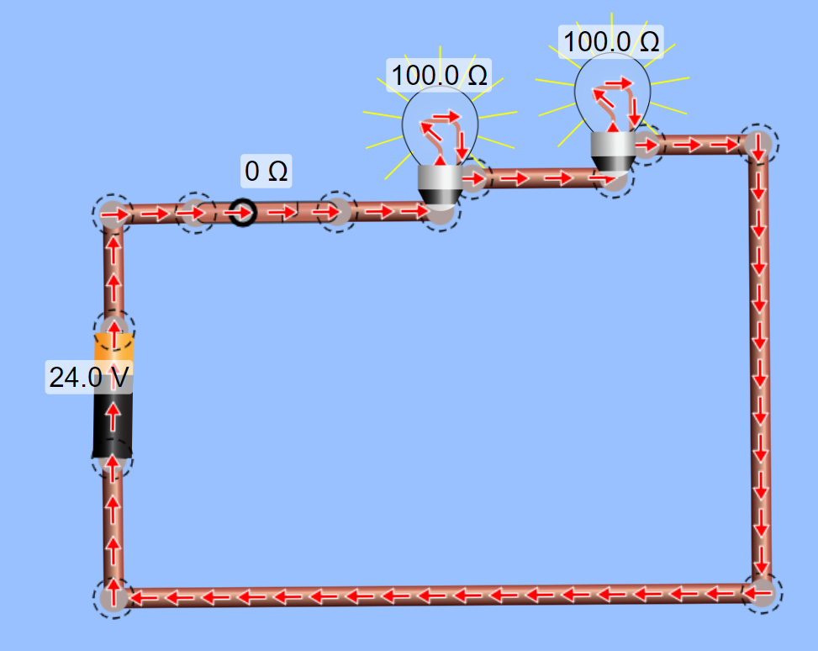
SERIES CIRCUITS
Calculate the following:
Total Resistance (RT)
Total current (IT)
Voltage Across Lamp 1 and Lamp 2
V_{R2}
V_{R1}
I (A)

Slide 23
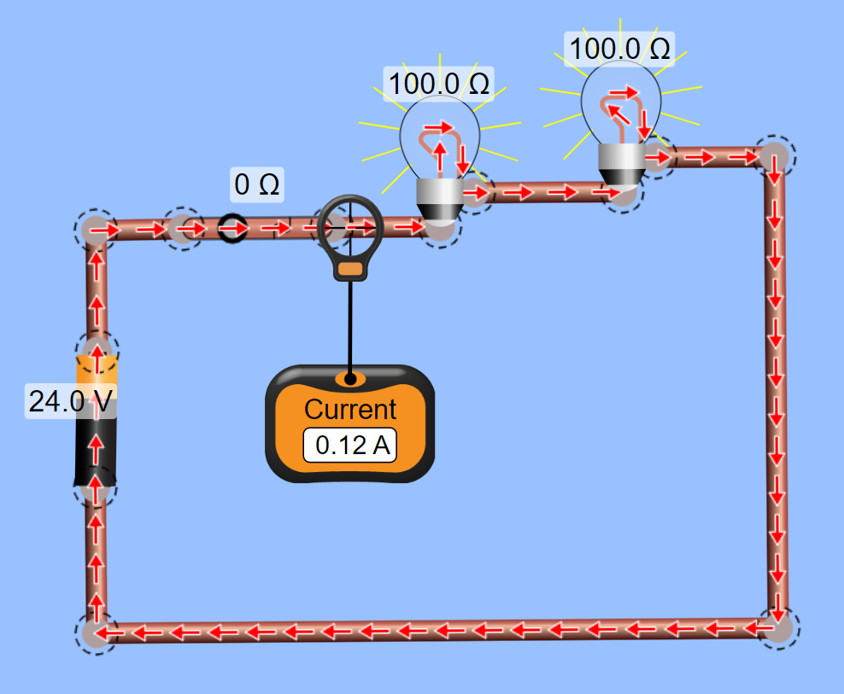
SERIES CIRCUITS
Given:
V = 24 V
R1 = 100 Ω
R2 = 100 Ω
Solution:
RT = R1 + R2
RT = 100 Ω + 100 Ω
RT = 200 Ω
I = V/R
I = 24 V/ 200 Ω
I = 0.12 A

Slide 24
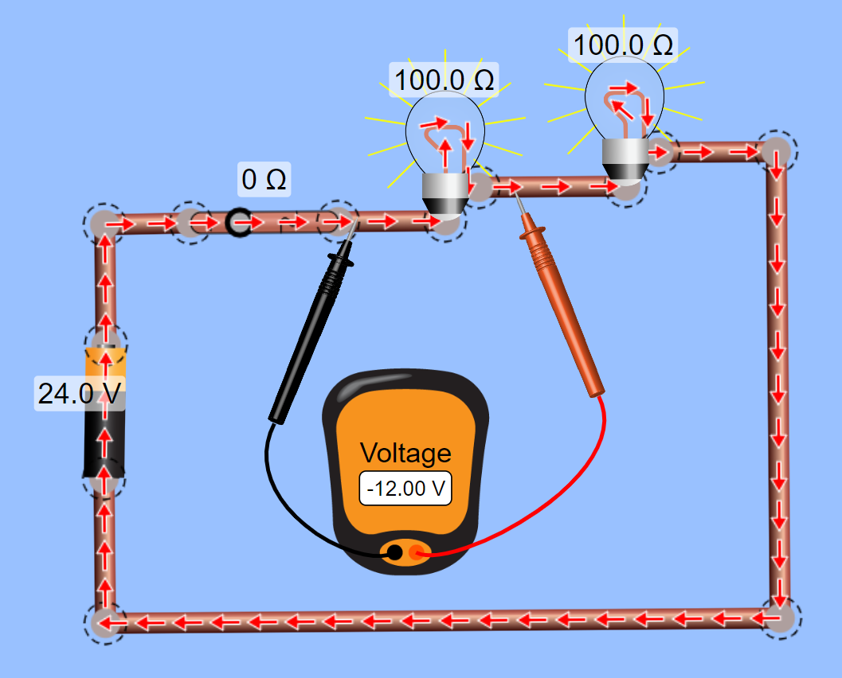
SERIES CIRCUITS
Given:
I_{T} = I_{R1} = I_{R2} = 0.12 A
R₁ = 100 Ω
R₂ = 100 Ω
Solution:
V_{R1} = I_{R1} x R₁
V_{R1} = 0.12 A x 100 Ω
V_{R1} = 12 V

Slide 25
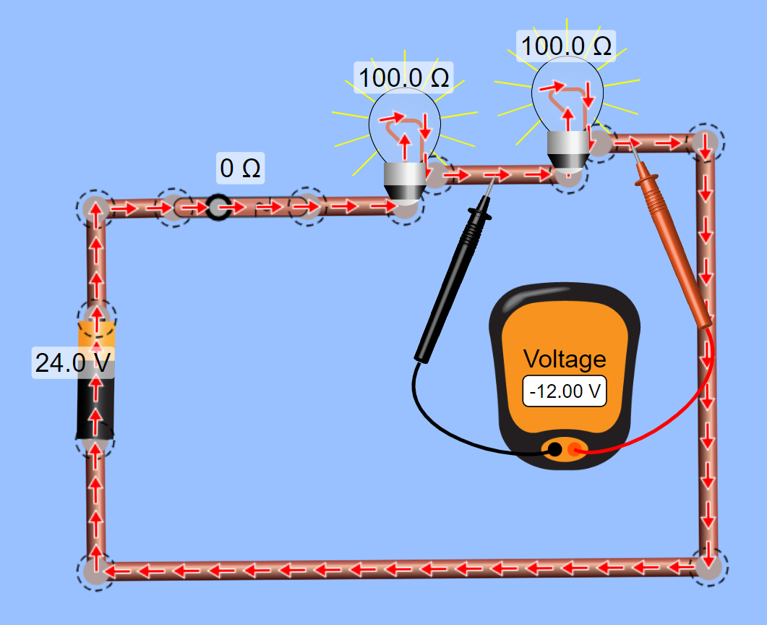
SERIES CIRCUITS
Given:
IT = I1 = I2 = 0.12 A
R1 = 100 Ω
R2 = 100 Ω
Solution:
VR2 = I2 x R2
VR2 = 0.12 A x 100 Ω
VR2 = 12 V

Slide 26
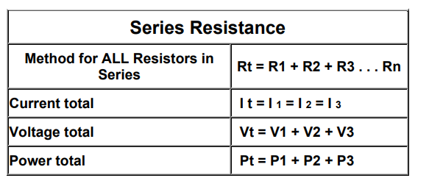
FORMULA REVIEW

Slide 27
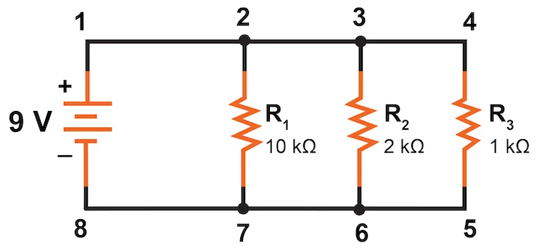
PARALLEL CIRCUITS
The voltage across every parallel component is equal.
The reciprocal of the total resistance (1/R_{T}) is equal to the sum of all of the reciprocal resistances (1/R₁ + 1/R₂ + 1/R₃).
The sum of all of the currents in each branch (I_{R1} + I_{R2} + I_{R3}) is equal to the total current (I_{T}). Refer to Kirchhoff’s Current Law.
V_{T} = V₁ = V₂ = V₃
1/R_{T} = 1/R₁ + 1/R₂ + 1/R₃
I_{T} = I_{R1} + I_{R2} + I_{R3}

Slide 28
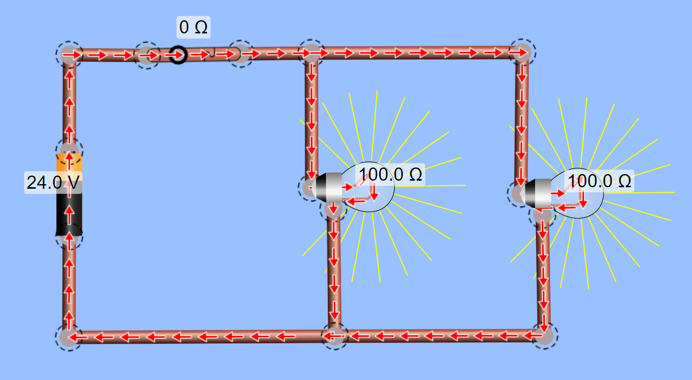
PARALLEL CIRCUITS
Calculate the following:
Total Resistance (RT)
Currents (IT, I1, I2)
Voltage Across Lamp 1 and Lamp 2 (VR1, VR2)
I_{T}
I_{R1}
I_{R2}
V_{R1}
V_{R2}

Slide 29
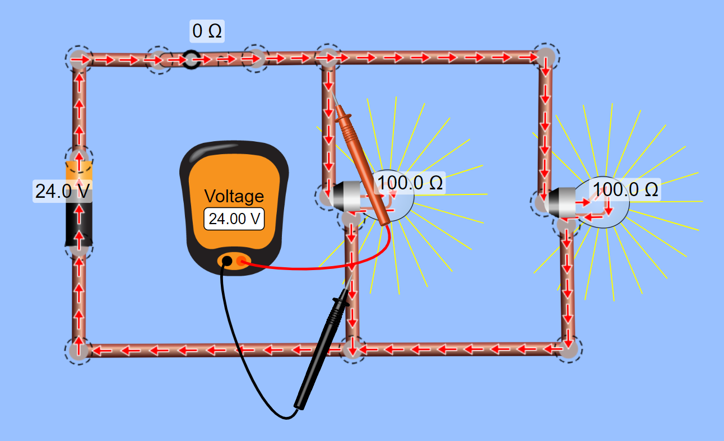
PARALLEL CIRCUITS

Slide 30
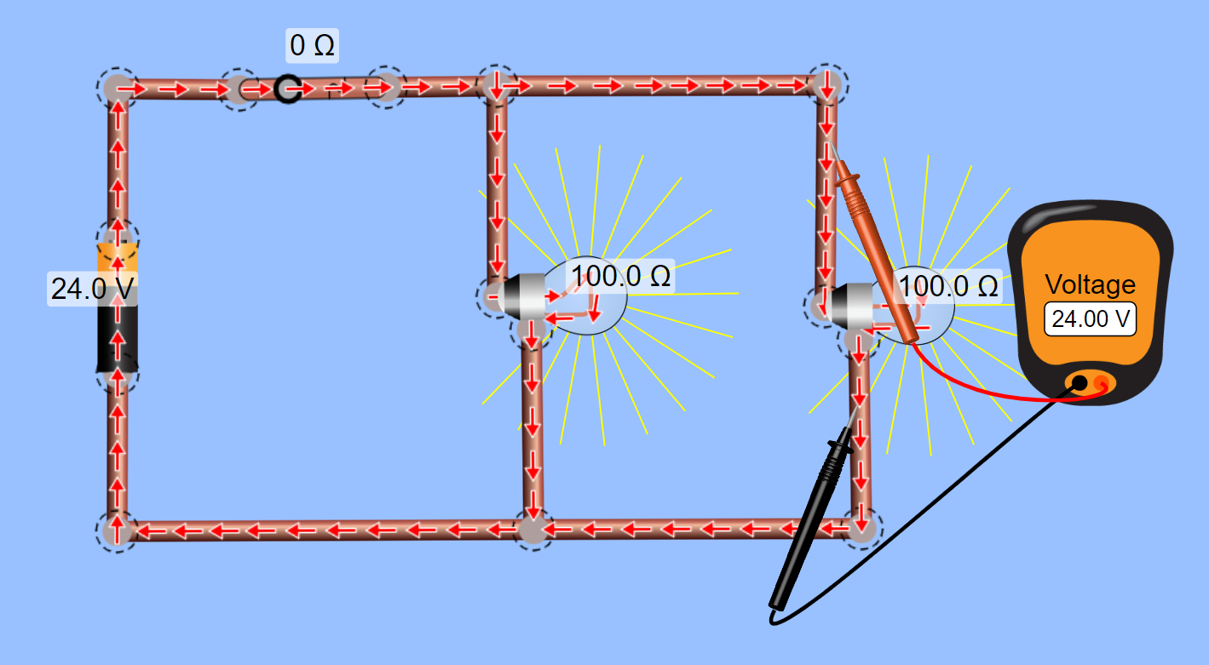
PARALLEL CIRCUITS

Slide 31
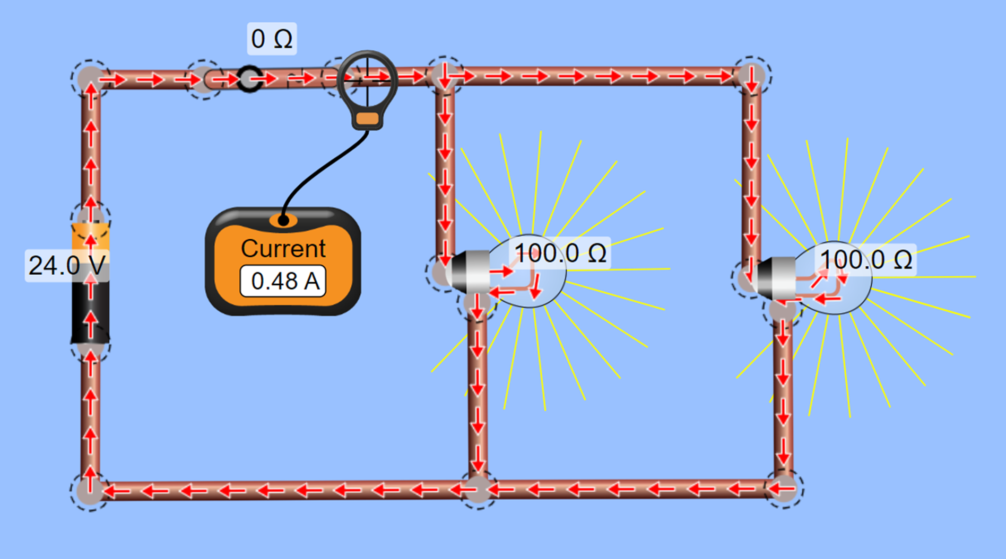
PARALLEL CIRCUITS
Given:
VT =VR1 = VR2 = 24 V
R1 = 100 Ω
R2 = 100 Ω
Solution:
1/RT = 1/R1 + 1/R2
1/RT = 1/100 Ω + 1/100 Ω
1/RT = 1/50 Ω
RT = 50 Ω
IT = V/R
IT = 24 V/ 50 Ω
IT = 0.48 A

Slide 32
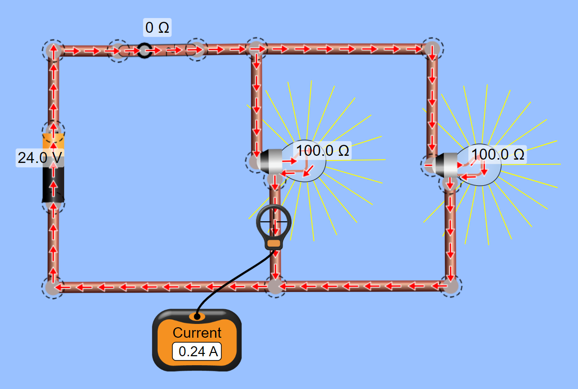
PARALLEL CIRCUITS
Given:
VT =VR1 = VR2 = 24 V
R1 = 100 Ω
R2 = 100 Ω
I_{R1}
Solution:
IR1 = VR1 / R1
IR1 = 24 V / 100 Ω
IR1 = 0.24 A

Slide 33
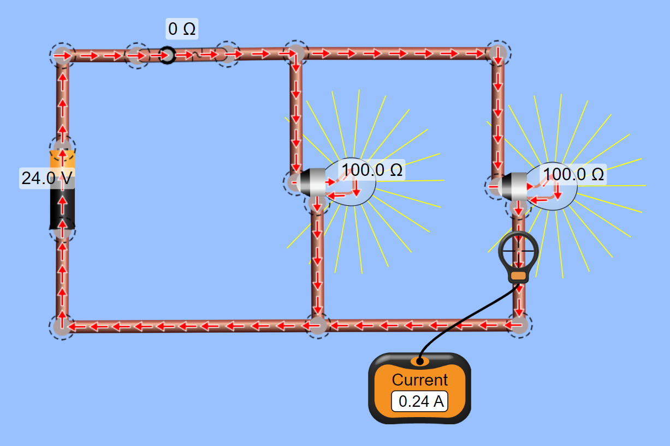
PARALLEL CIRCUITS
Given:
VT =VR1 = VR2 = 24 V
R1 = 100 Ω
R2 = 100 Ω
Solution:
IR2 = VR2 / R2
IR2 = 24 V / 100 Ω
IR2 = 0.24 A

Slide 34
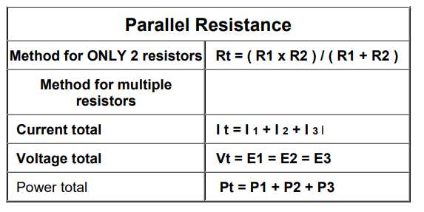
FORMULA REVIEW
1/R_{T} = 1/R₁ + 1/R₂ + 1/R₃

Slide 35
OPEN AND SHORT CIRCUITS
An open circuit is a circuit in which the continuity is broken due to which the electric current can not flow.
A short circuit is a very low resistance, direct connection between two terminals of a network.
0

Slide 36
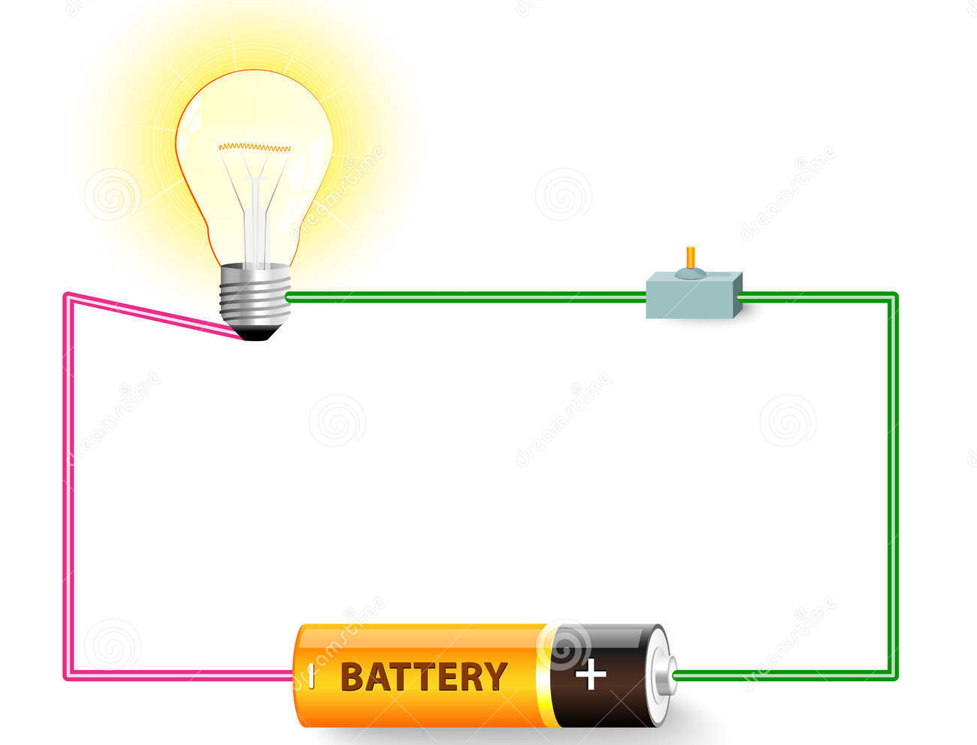
SHORT CIRCUIT CURRENT
I_{CS} (kAIC) >I_{F}
I_{N} (AT) > I_{B}
CB
R_{L} = 5 Ω
I_{f} = 240 A
I_{B} = 4.71 A
R_{F} = 0 Ω
R_{W} = 0.1 Ω
24 VDC

Slide 37
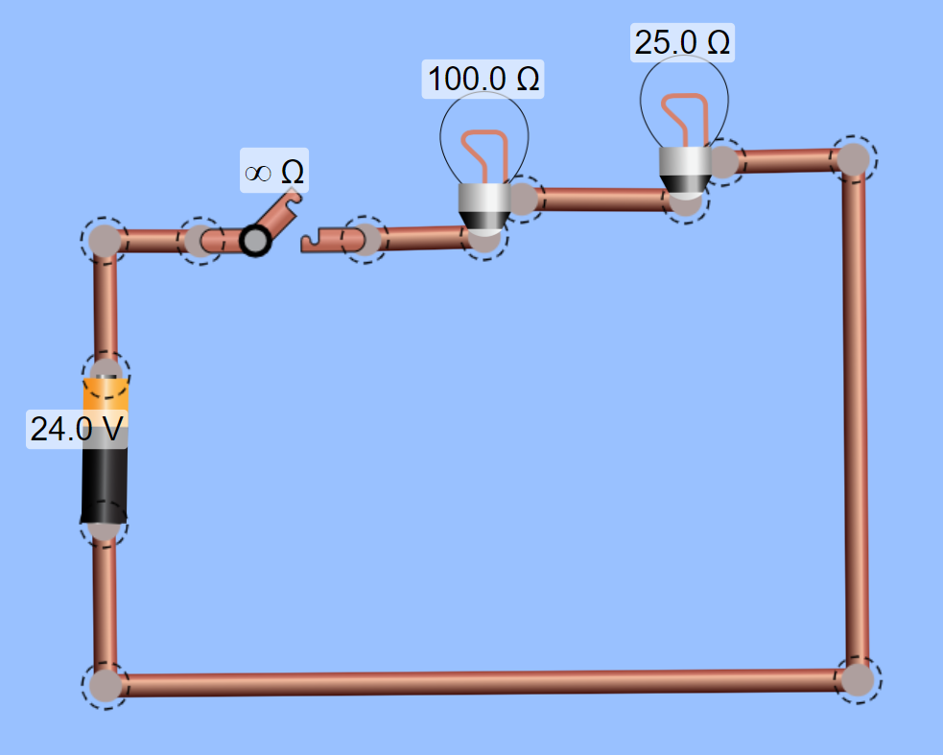
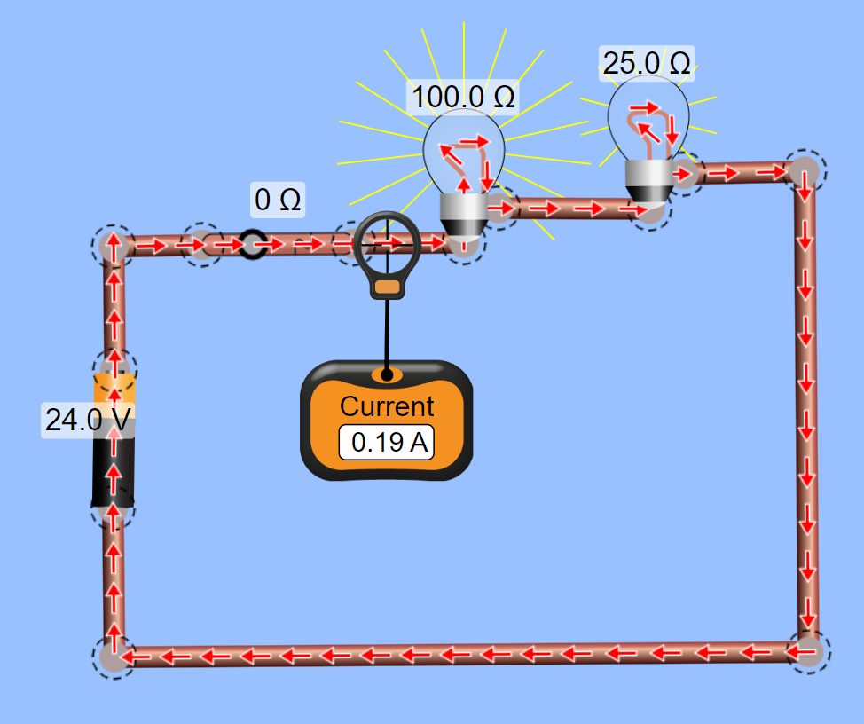
CIRCUIT ANALYSIS
I (A)

Slide 38
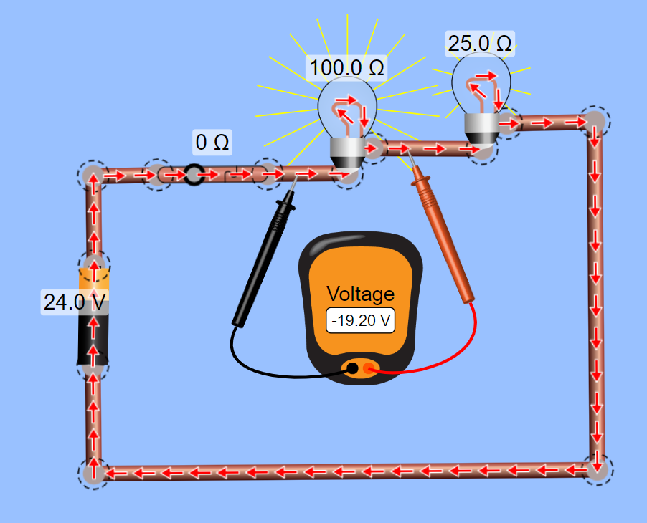
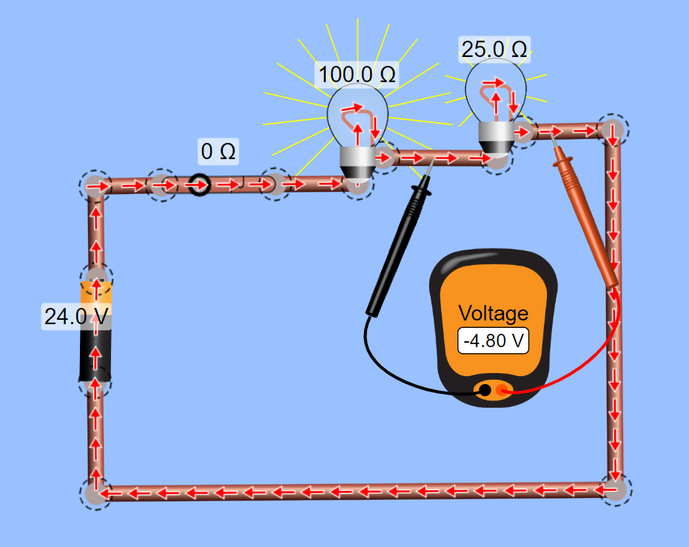
CIRCUIT ANALYSIS

Slide 39
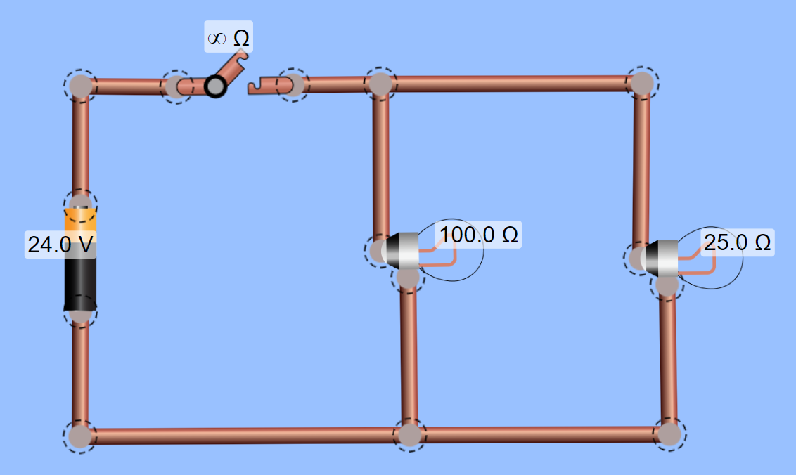
CIRCUIT ANALYSIS

Slide 40
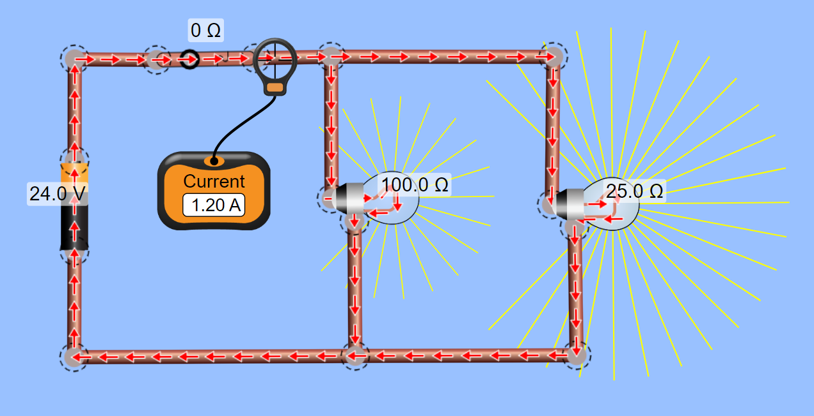
CIRCUIT ANALYSIS

Slide 41
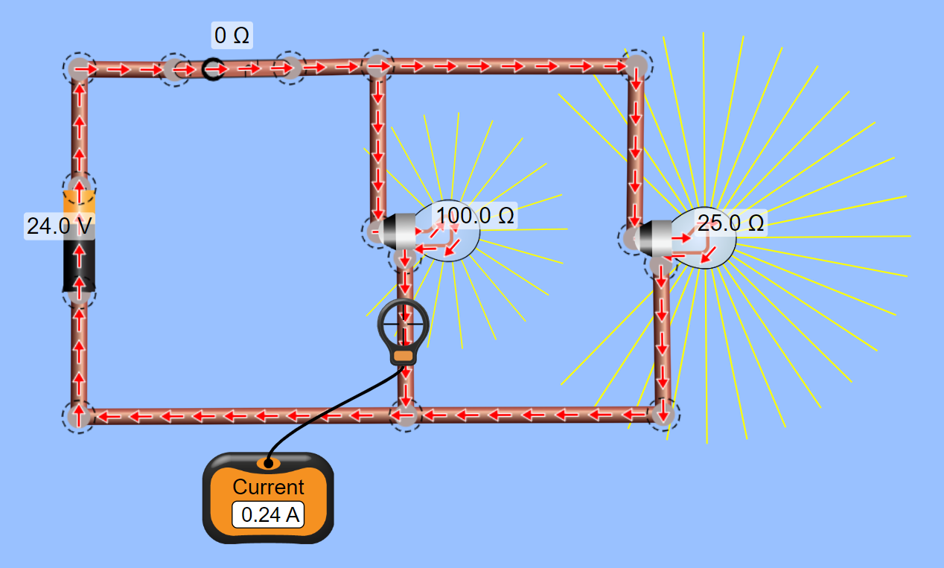
CIRCUIT ANALYSIS

Slide 42
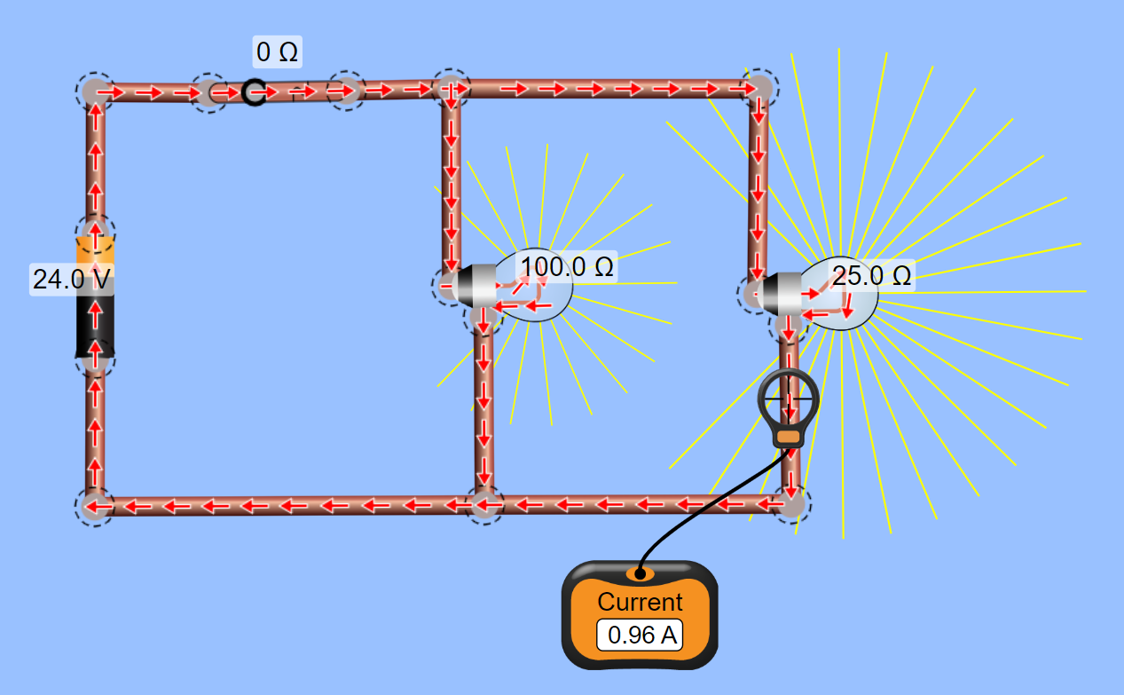
CIRCUIT ANALYSIS

Slide 43
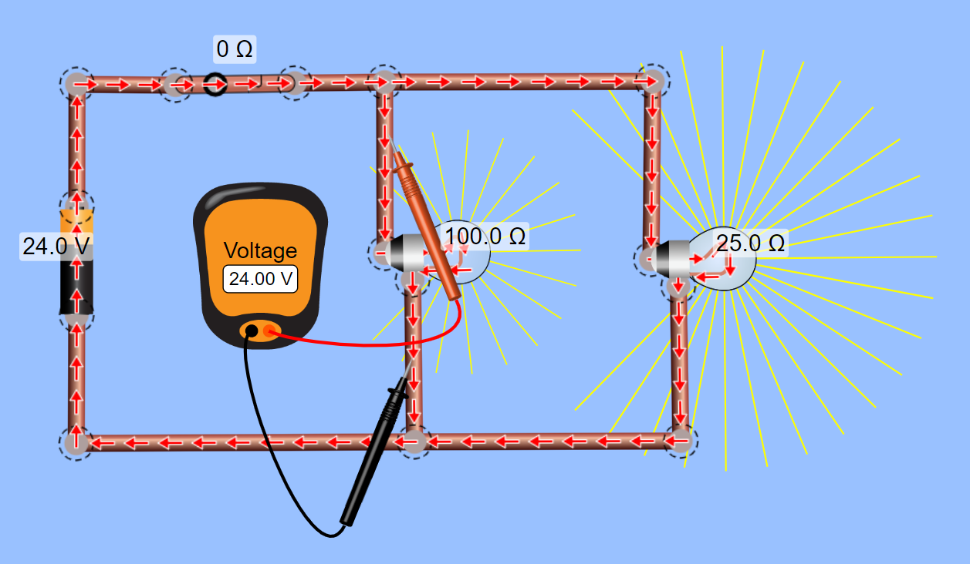
CIRCUIT ANALYSIS

Slide 44
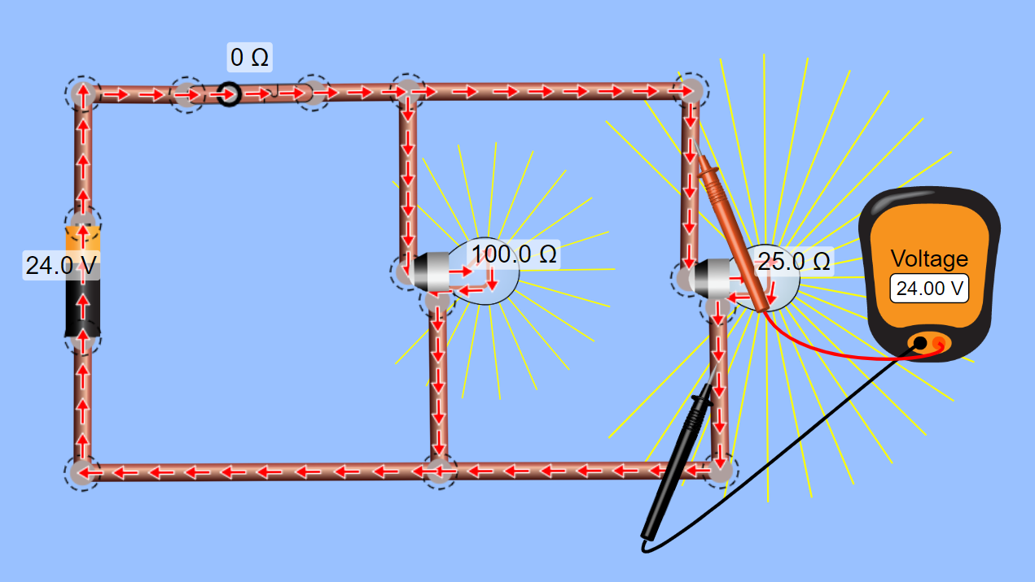
CIRCUIT ANALYSIS

Slide 45
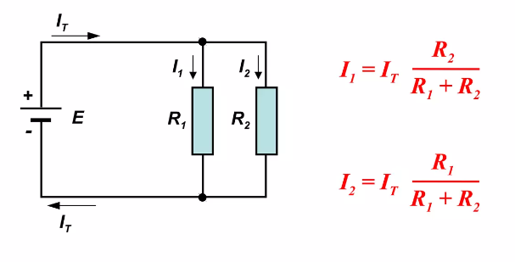
CURRENT DIVIDER PRINCIPLE
In parallel circuits, the current I_{T} divides up through the various branch networks, I₁ and I₂.
The ratio between any two branch currents is the inverse ratio of the branch resistances.

Slide 46
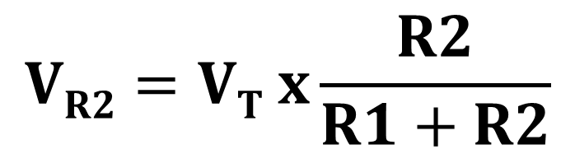
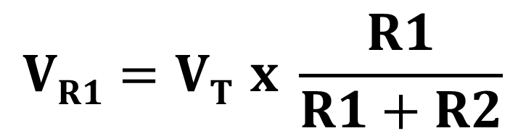
VOLTAGE DIVIDER PRINCIPLE
The voltage drop across a series resistor is directly proportional to its magnitude.
The voltage divider principle easily calculates the voltage drop across a resistor that in connector in series to other resistors.
c
c
c
$$VR1=VT x \frac{R1}{R1+R2}$$
$$VR2=VT x\frac{R2}{R1+R2}$$

Slide 47
PROBLEM SOLVING
Two resistors of resistance 3Ω and 6Ω are connected in parallel across a battery having a voltage of 12V. Determine (a) the total circuit resistance and (b) the current flowing in the 3Ω resistor.
For the circuit shown below, determine (a) the voltage across R3. If the total resistance of the circuit is 100Ω, determine the current flowing through resistor R1. Find also the value of resistor R2.
10V
25
4V
V3

Slide 48


DANGERS OF ELECTRICITY
Electrical fires are primarily caused when electrical energy heats an object above its ignition temperature.
Excessive heat resulting in a fire can be generated when wires are not terminated properly, or not properly sized and the load exceeds the rating of the circuit's components.
Electric shock or electrocution is dependent on the current flowing through the body and is impacted by both the contact voltage and the contact resistance.
Arc flash can create deadly and harmful consequences to humans and their surroundings with excessive temperatures reaching up to four times the surface temperature of the sun.

Slide 49

ELECTRICAL SAFETY
Incidents involving electricity can cause burns, explosions, shocks, and death, and are a major cause of building fires.
Electrical Safety Program shall be developed to help individuals recognize and avoid electrical hazards.
The goal is to reduce and manage the risk of electrical arc flash hazard, shock, equipment damage, and fire.

Slide 50

GENERAL SAFETY RULES
NEVER WORK ON AN ENERGIZED CIRCUIT IF THE POWER CAN BE DISCONNECTED.
When possible, use the following three-step check to make certain that power is turned off:
1. Test the meter on a known live circuit to make sure the meter is operating.
2. Test the circuit that is to become the de-energized circuit with the meter.
3. Test the meter on the known live circuit again to make certain the meter is still operating.
“The Golden Rule”

Slide 51

LOCK-OUT AND TAG-OUT
Lock out and tag out (LOTO) procedures are generally employed to prevent someone from energizing a piece of equipment by mistake. This could apply to switches, circuit breakers, or valves.
The person performing the work places the lock on the equipment and keeps the key in his or her possession.
Safety lock-out hasp is a device that permits the use of multiple padlocks and a safety tag.
This is used when more than one person is working on the same piece of equipment.
Violating lock and tag out procedures is considered an extremely serious offense.

Slide 52

ELECTRIC CURRENT BEHAVIOR

Slide 53


ELECTRICAL SHOCK
Electric shock occurs when the human body becomes a conductor, completing the path for current to flow.
Basic electrical safety is that if a path is not complete, current will not flow, and shock will not occur.
Like water, electricity will take the path of least resistance.
Current will most likely flow through a circuit instead of a human body unless the body presents a path of lower resistance.

Slide 54


EFFECTS OF ELECTRIC CURRENT ON THE BODY
“Current kills a person. However, do not be mislead into thinking voltage cannot harm you. Voltage is the force that pushes the current though the circuit. So, with constant resistance, the higher the voltage, the higher the current.”

Slide 55


ELECTRICAL GROUNDING
Earthing or grounding is used to protect you from an electric shock.
It provides a low resistance path (a protective conductor) for a fault current to flow to earth.
It also causes the protective device to trip in the event of an earth or ground fault.

Slide 56

EARTH LEAKAGE PROTECTION

Slide 57



GROUND FAULT CIRCUIT INTERRUPTERS
GROUND FAULT
CIRCUIT BREAKER
GROUND FAULT
RECEPTACLE
GROUND FAULT
EXTENSION
https://www.youtube.com/watch?v=ggJo6m8NZtA

Slide 58

ELECTRICAL PROTECION DEVICES
https://www.electricaltechnology.org/2019/07/mcb-mccb-elcb-rcb-rcd-rccb-rcbo.html

Slide 59

ARC FLASH ANALYSIS
Arc Flash Boundaries – the distance from exposed energized electrical components within which a person could receive a second degree burn if an electrical arc flash occurs.
Limited Space Boundary – the approach distance to exposed energized electrical components within which a shock hazard exists. It is the approach limit for unqualified persons.
Restricted Space Boundary – the approach limit for qualified person to exposed energized electrical components where there is an increased of electric shock due to electrical arc-over combined with inadvertent movement.
Arc Flash and Shock Protection Boundaries

Slide 60



ARC FLASH ANALYSIS

Slide 61




END OF THE PRESENTATION
THANK YOU FOR YOUR ATTENTION
TRILOGIX TRAINING INSTITUTE
+971506675357
(04) 3595338
www.trilogixtiatc.com

